Slide 1


Basic I.T Skills Training
Delivered by
Mr. Edward Charles Richmond BSc (Hons) MBCS SCL

Slide 2
Lesson Three
The Internet
Cyber Security/Password managers
Open Floor

Slide 3
Quick recap of last week
Different file types are used for different purposes and can contain different levels of information.
It’s important to know which file type to use depending on the situation (e.g. csv vs xlsx, raster v vector).
The internet is made up of lots of connected devices/networks. All of these devices/networks are managed independently, but in principle should comply with the international and national law.
We can use a web browser (edge, chrome, firefox) to browse the internet, create accounts and send email.
Emails can contain attachments, formatted text, links and more.

Slide 4
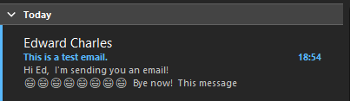
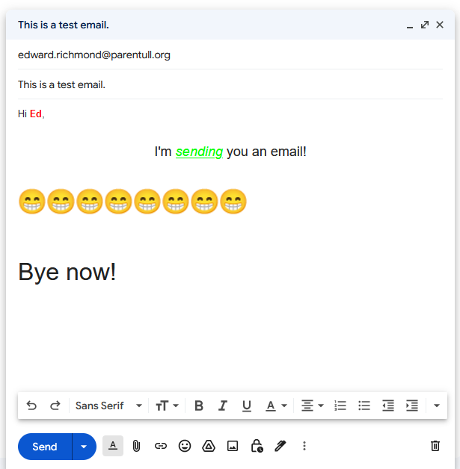
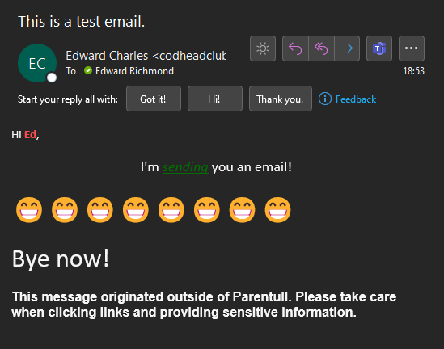
Example

Slide 5
Internet
We can use the internet to access services and tools which make life easier. From email, ecommerce and search to streaming, communities and cloud services. But it’s important to know how to stay safe and recognise threats, risks and scams.
Let’s find out more!

Slide 6
Browsers
What is a browser?
Could be described as a persons portal to the internet.
It allows for requests to be sent across the internet for information a person is looking for and returns that information in a (hopefully) readable format.
Provides access to previously saved information, such as bookmarks and pinned tabs.
If configured, it syncs information across devices too.

Slide 7
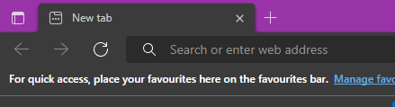
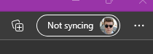
Browsers
Menu to settings, bookmarks etc.
Tab
New Tab Button
Sync status
Backwards/Forwards Buttons
Collections (saved content for later)
Refresh button
Address bar.
Most browsers allow both searches and direct URLs – such as google.com or facebook.com.

Slide 8
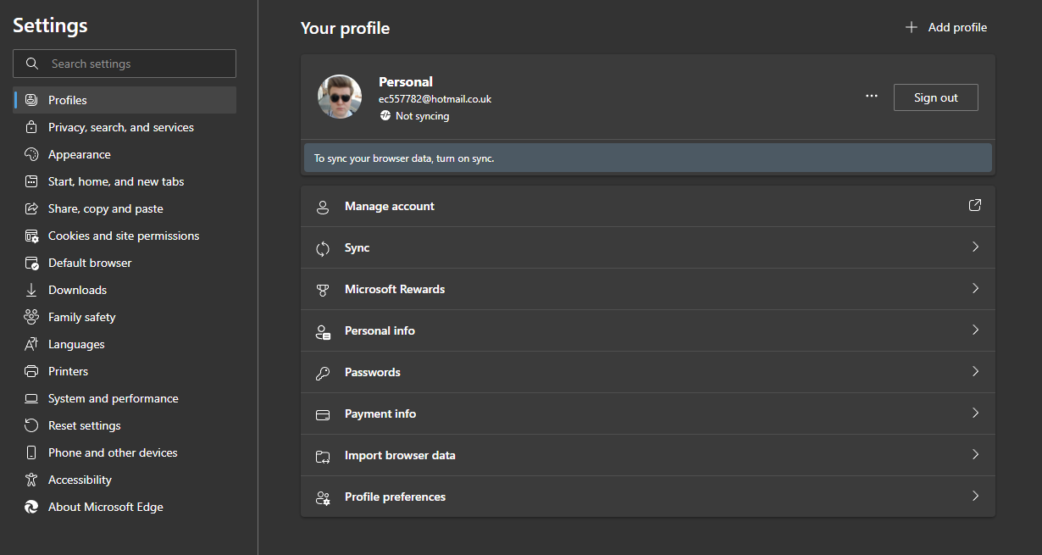
Browsers

Slide 9
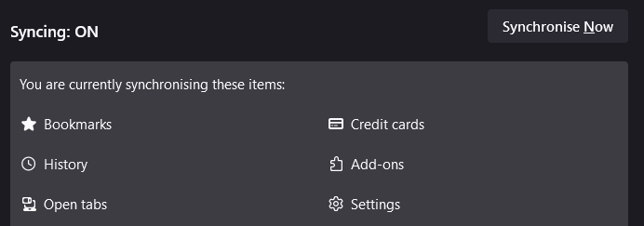
Browsers

Slide 10





Browsers
Google Chrome | Microsoft Edge | Mozilla Firefox | Brave Browser | Safari Browser
Built by Google Most used browser in the world presently. Doesn’t block cookies by default Can manage passwords / credit cards & google accounts. Commercial | Built by Microsoft Uses the same “engine” as Google Chrome. Blocks some cookies by default Syncs Microsoft account + other Microsoft ecosystem services. Commercial. | Built by the Mozilla Foundation Does not use Chromium engine. Blocks third party cookies / trackers by default. Optional account sync. (Mozilla account) Open Source | Built by Brave Software Inc Uses Chromium (same as Google Chrome) Privacy focused but does sell adverts + other services through it’s software. Open Source | Built by Apple Up to 50% faster than Chromium based browsers (based on 2020 tests) Restricts some ad blocking Commercial

Slide 11
Staying safe online
Old School Principles still apply to the internet.
Buyer beware
Do research on the site/vendor – and ask for recommendations
Check the company on companies house to see if they actually exist (only works for UK companies).
Check the bottom of the website to see if they have a privacy/returns policy.
Check review sites, or social media presence.
Step back from the situation and ask yourself if there is an unnecessary urgency in the transaction or the transaction is confusing (e.g. Not a straight for exchange of cash for goods/services).
Shop smart – check around for cheaper prices.
https://smile-collections.com/?s=shed&post_type=product
https://uk.trustpilot.com/review/smile-collections.com
Stranger danger – Unless you know the person you are interacting with in person, treat them as a stranger and do not give out personal information. For any reason.

Slide 12
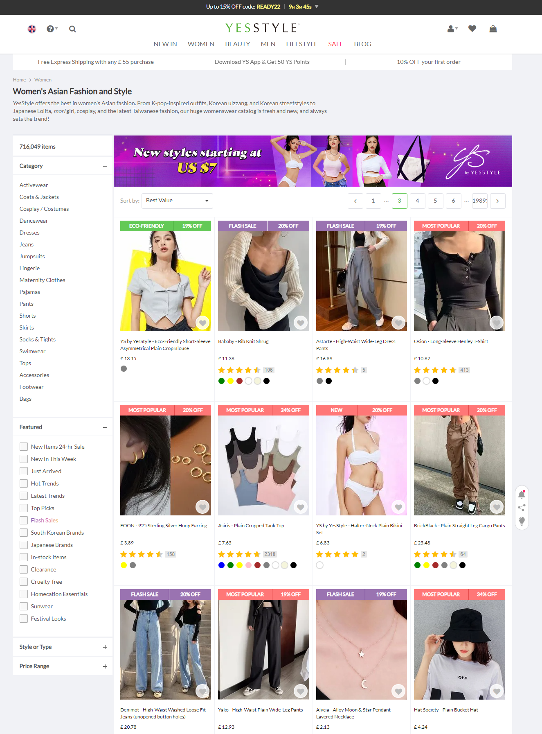
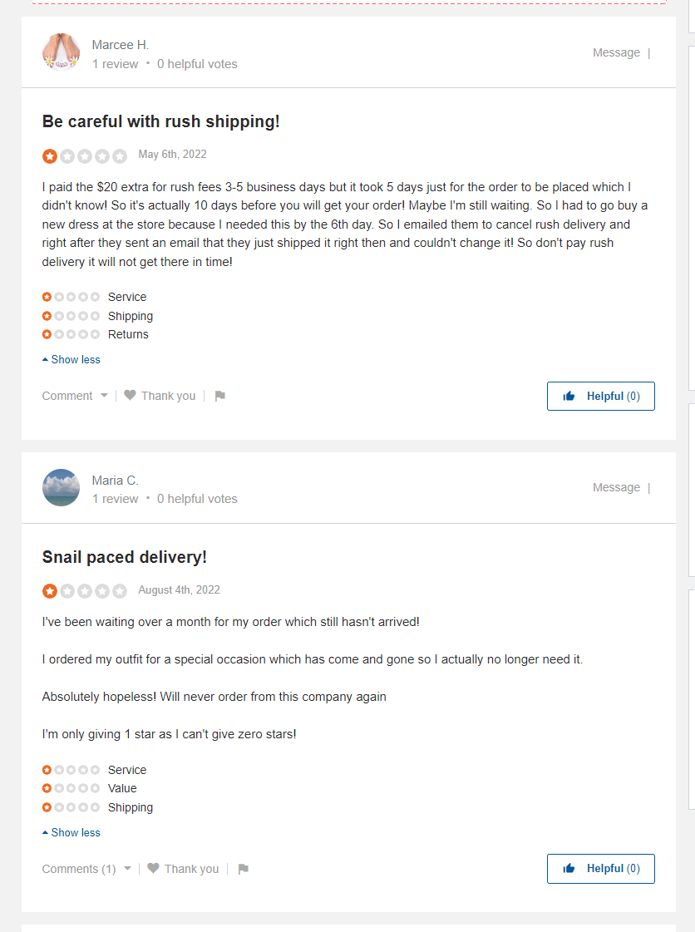

Slide 13
Staying safe online
Old School Principles still apply to the internet.
Stranger danger – Examples
Dragon Lord – German man who challenged internet trolls to come to his home address on Youtube. Years of online and offline harassment ensued with people turning up at his house, sending threats, pretending to be in love with him and so on.
Tinder Swindler – Man used dating app to convince women around the world he was super wealthy. Subsequently he would convince them to date, enter a relationship or become friends. When he had enough trust, he’d ask for lots of money for an “emergency”. https://youtu.be/_R3LWM_Vt70
Catfish – TV Show about people who have fallen in “love” over the internet but not met in person. Throughout each episode, one of the partners is revealed to be a “Catfish” – meaning they are pretending to be someone else, either maliciously or for another reason.
Here’s why - https://youtu.be/lc7scxvKQOo

Slide 14
Staying safe online
Old School Principles still apply to the internet.
Practice safe s.. – Make sure connections are secure and verified before clicking them to reduce the risk of viruses, trackers & other malicious attack vectors.
This means making sure links start with https:// and the link is genuine – for example, https://google.com not https://goolge.com or https://googleofficial.jj
If genuine, the https:// means the site has an SSL (Secure Sockets Layer) Certificate which validates the connection between your computer and the services server.

Slide 15
Staying safe online
Browsers can be very helpful in ensuring secure connections through the use of extensions.
Extensions are small “apps” for your browser which perform certain functions. For example, forcing connections to use https:// or blocking adverts.
If you are using chrome, go to https://chrome.google.com/webstore/category/extensions
Have a go at finding extensions for your web browser during the lesson!

Slide 16
Search
As part of staying safe online, I want to increase confidence in searching online. The reason for this is that if we can get better at searching, we can get better at finding information – to avoid scams, to help with a task, to determine whether to trust an online vendor and so on.
As such, we are going to use Google.com to do different types of search. You may already know how to do this, but it’s worth reinforcing the knowledge.

Slide 17
Search
It’s possible that you’ve gone to google.com and entered some text before, for example “fluffy bunnies”. This told google you wanted to look for fluffy bunnies and in return, google gave you results about fluffy bunnies.
But, what happens if you want specific results? Say, for a specific site or an explicit phrase? Or even, a specific image?
We can use operators to enhance the search thereby getting better results.

Slide 18
Search
Open your browser
In the address bar, type google.com
The first search we will perform is to search a specific site
In the search bar, type: site: amazon.com chairs
Once you hit enter, you should be presented with results from only Amazon and only about chairs.

Slide 19
Search
Now lets try an explicit phrase –
Go back to google.com
Use quotation marks (“..”) and search for “Brexit means Brexit”
This time, you’ll see results from lots of different sources but they will all contain the phrase “Brexit means Brexit”.

Slide 20
Search
Now that we’ve covered explicit phrases, what if we want to exclude a phrase? Say for example, if we wanted to exclude the word “Brexit”
Go back to Google.com
Type News –Brexit
This will give you news results without anything Brexit related.
Try site: bbc.co.uk news “hull” What happens?

Slide 21
Search
There are lots more operators to try.
Search using a specific image which you can upload from your computer. This will return any images which are the same, or like that image.
OR will return x OR y from the search terms you use – for example: site: bbc.co.uk news “-Brexit” OR “-Ukraine”
Search location using map:
There’s a full list at https://ahrefs.com/blog/google-advanced-search-operators/

Slide 22

Tea break
After the break: Cyber Security

Slide 23
Cyber Security

Slide 24
POLP – Principle of Least Privilege
This is the idea that people should not have more privileges or access to information than they need for the job that they are performing. Usually, this is applied to work environments and controls what can be accessed by staff members.
I think it can also be applied in personal lives too. For example, a child should not have access to their parents passwords, credit cards or mobile phone for the risk of the child using them for their own gain.

Slide 25
Networks
Over the last few weeks, we have looked at basic system use and networks. One potential attack vector is public and home networks.
When connecting to a public network, you should consider who else is using that network because it’s possible the traffic is being monitored or some other attack is being perpetrated.
Similarly, when someone wishes to connect to your home network, you should consider whether you trust that person enough to give them access. Most people assume that people using their network connections will browse the internet, but they may also gain access to other resources – such as personal files if your devices are configured to share them.

Slide 26
Networks
https://youtu.be/_s5NDXYY-Z8
Networks can be monitored for unusual activity using Glasswire

Slide 27
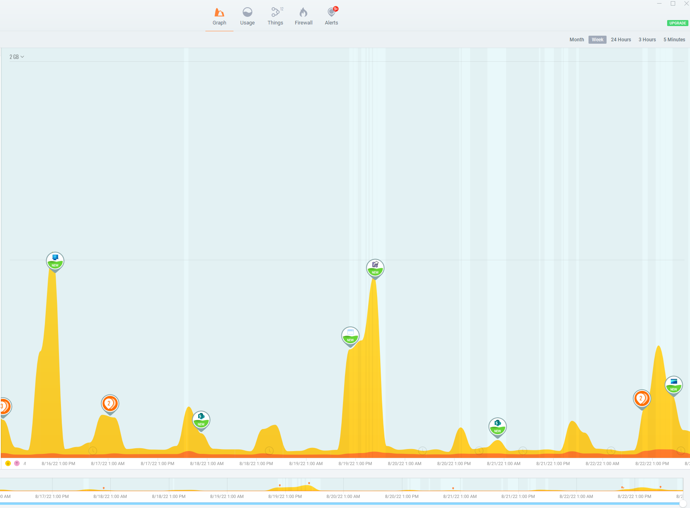

Slide 28
Keeping accounts secure
Cracking a username/password is very easy. In some cases, a hacker doesn’t even need to crack the password because it’s been leaked online via a third party (e.g. a company who has been hacked).
For this reason, you should never use the same password for your accounts. Always use a different password and change them at regular intervals.
Longer passwords are better, but a common misconception is that passwords with special characters in them are stronger. That’s not true, a longer password will beat a password with special characters.
https://youtu.be/7U-RbOKanYs?t=426

Slide 29

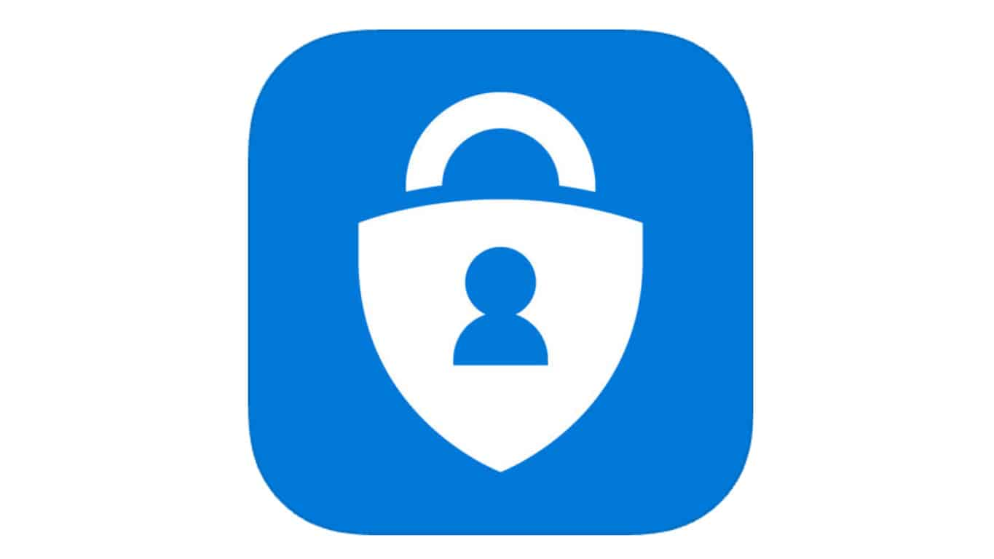
Keeping accounts secure
Multi-factor authentication has been introduced to add another layer of security. MFA (or 2fa) will ask for a code or another piece of information which only you as the account owner would know.
This piece of information, as well as the password verifies you and allows the action, for example, logging in or a purchase, to take place.

Slide 30
Keeping accounts secure
Smart phones play a key part in this process – they receive notifications, text messages or run applications which supply codes as part of the 2fA/mfa process.
Smart phones are also essential to passwordless accounts. These are accounts which no longer use a password, instead opting to use devices, mfa processes and the users habits to detect security threats.

Slide 31
Password Managers
We can use password managers to store complicated passwords and login details for ease of administration. Today, we’ll sign up to LastPass and walk through the process of storing some passwords.
To begin, we need to open our browser and go to lastpass.com Click personal > Start storing my passwords > Fill in details on form
You may want to use https://strongpasswordsgenerator.net/ to generate your master password.

Slide 32
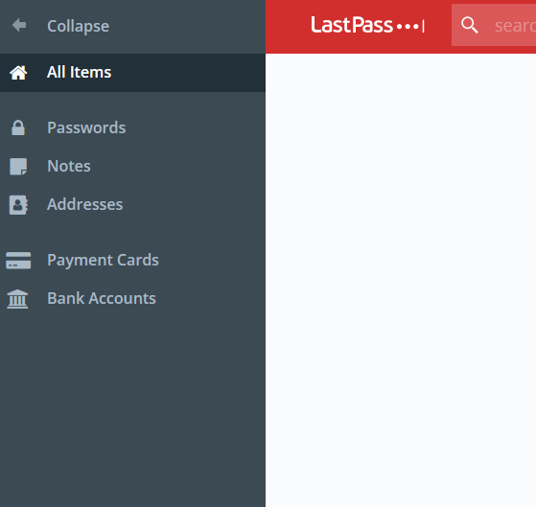
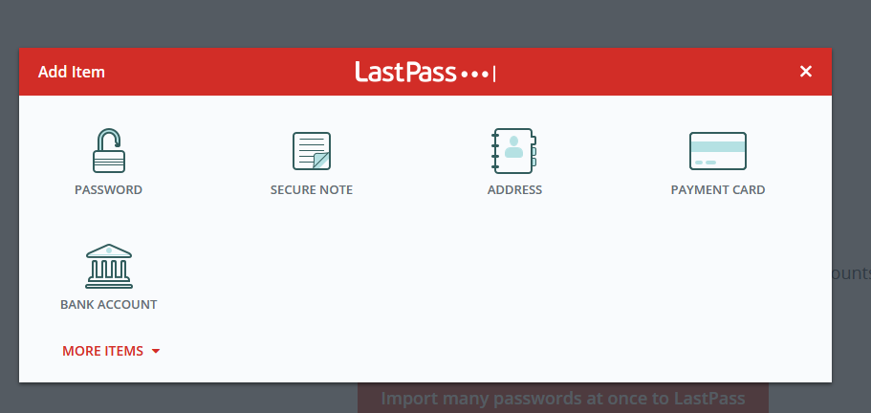
Password Managers

Slide 33
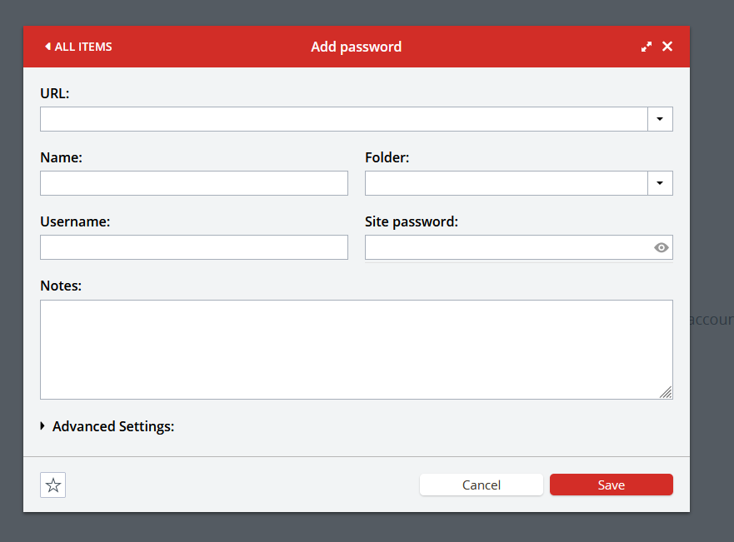
Password Managers

Slide 34
Finally on Cyber Security
There is a LOT we haven’t covered because this topic is very broad ranging but I’ve tried to cover the essentials – secure passwords, MFA/2FA, controlling networks and device access and POLP.
Together, they can help keep you more secure from cyber threats.
But remember, most threats do not come from machines – they come from people. Like this teenager -
https://www.bbc.co.uk/news/uk-england-leicestershire-41527941

Slide 35
Open Floor
This is your time to ask questions about a specific area of technology.
Please be considerate of others and allow me to answer a question then move on and help someone else!

Slide 36
Feedback/Questions?
If you have a question in between classes, feel free to email me at edward.richmond@parentull.org

